Slide 1
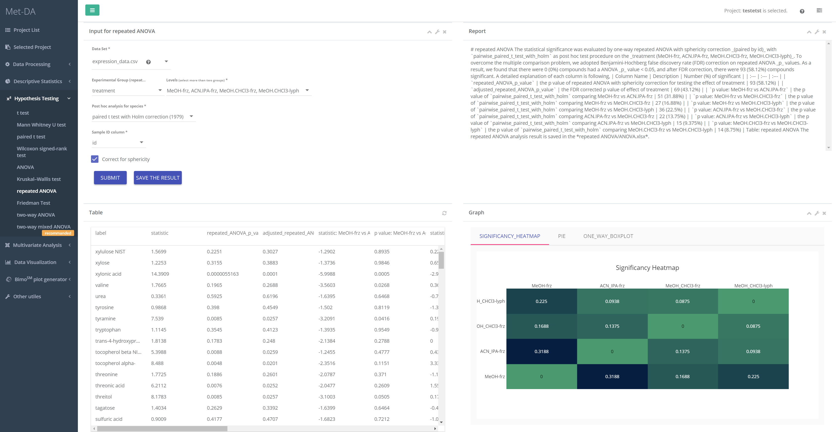
1
4
3
5
2

Slide 2
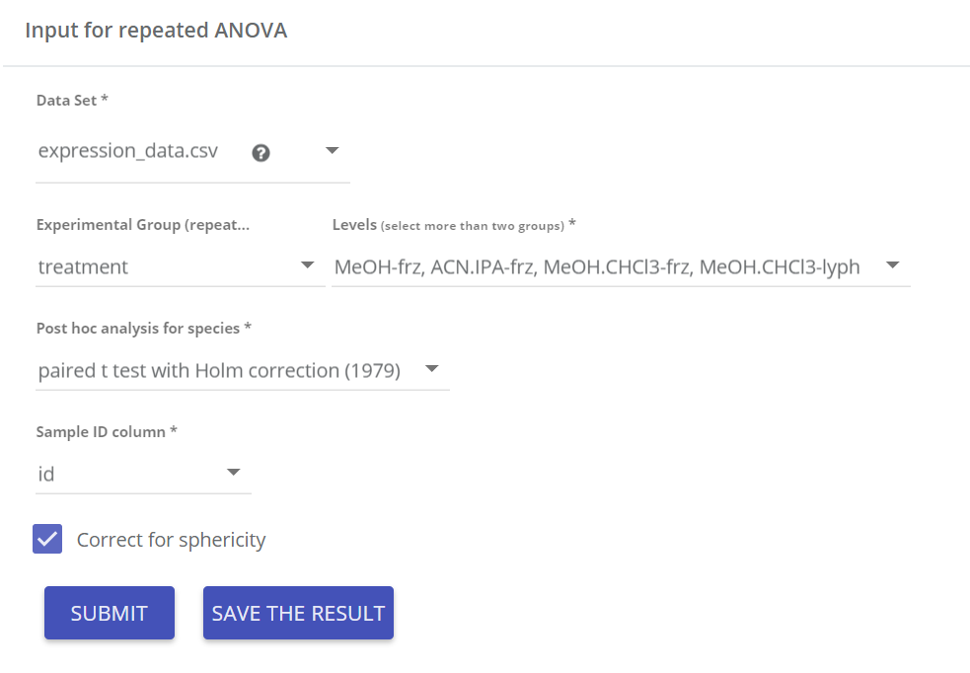
Input parameters
Data matrix for repeated ANOVA
Select more than two groups you would like to test
Choose post hoc analysis method comparing each pair of two groups, e.g. MeOH-frz vs ACN.IPA-frz
Sample id is required for paired/repeated measure study to tell which columns of data are measured from same sample. OR how are samples paired.
Assumption of sphericity: equal variance of the differences of all the pair of two groups
1

Slide 3
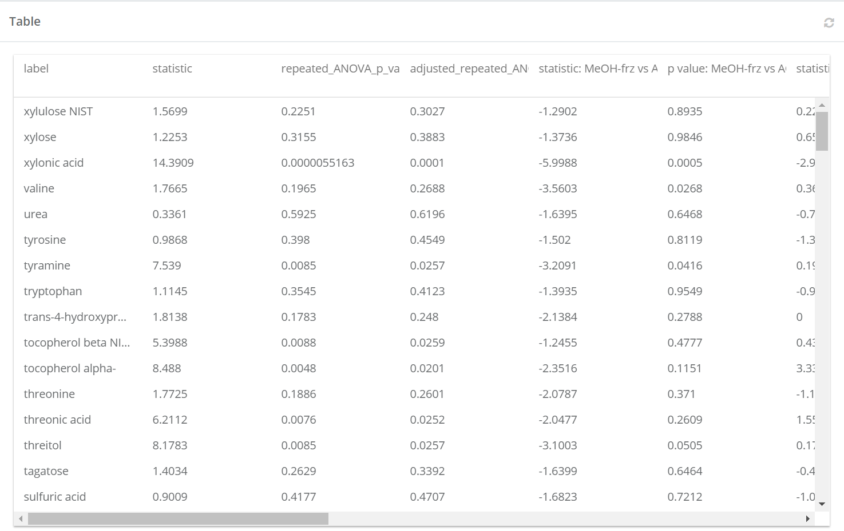
Result table
statistic:
Repeated ANOVA does not have negative statistic.
ANOVA_p_value:
p value of repeated ANOVA
adjusted_ANOVA_p_adj:
Adjusted p value of repeated ANOVA for False Discovery Rate using Bonjanimi-Hochber correction
statistic: MeOH-frz vs ACN.IPA-frz:
Positive value means the average of value of MeOH-frz is larger than the ACN.IPA-frz.
Negative value means the average of value of MeOH-frz is less than the ACN.IPA-frz.
p value: MeOH-frz vs ACN.IPA-frz:
p value of post hoc analysis comparing each pair of two groups.
2

Slide 4
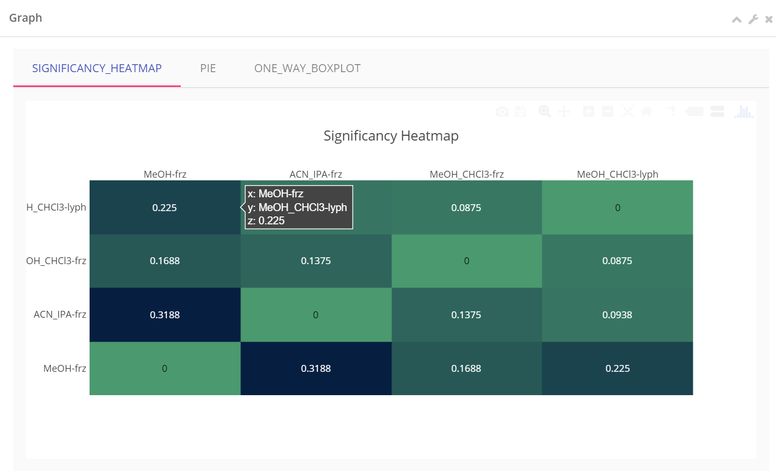
Visualizing the significant percentage
Heatmap visualization of the percentage of significant compounds. For example, 0.225 means that 22.5% of the compounds are significantly (p value < 0.05) different at MeOH-frz vs ACN.CLC3-lyph.
Click each cell to go to PIE chart visualization.
3

Slide 5
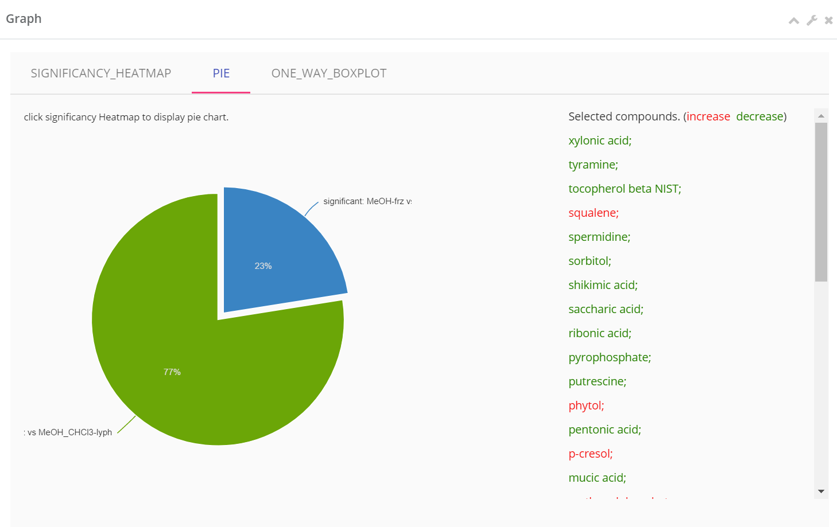
Pie chart visualization of the percentage of significant compounds.
Not significant: p value > 0.05
significant: post hoc analysis p value < 0.05
Click arc to display the compound names in each arc. increase means MoOH-frz is larger than MeOH.CHCl3-lyph.
4

Slide 6
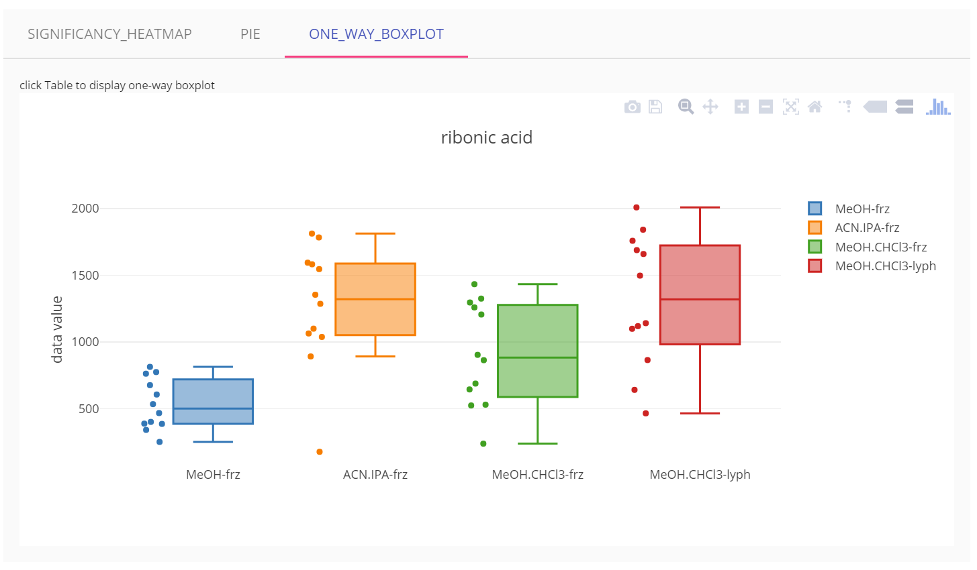
Visualizing each compound using boxplot
Click result table row to visualize each compound by boxplot.
Scatters next to boxplots are the sample values.
Boxplots for all the compounds can be generated/saved in Visualization->Boxplot.
5

